Slide 1
Cornerstone City Church Peninsula Plus Community Hoo Are Ya 07-05-2023

Slide 2
Every Praise
CCLI Song # 6623483
Hezekiah Walker | John David Bratton
© 2013 Davo Pavo Music (Admin. by BMG Rights Management GmbH)
Li'l Eva Music (Admin. by Capitol CMG Publishing)
Luv Ki Publishing (Admin. by Capitol CMG Publishing)
For use solely with the SongSelect® Terms of Use. All rights reserved. www.ccli.com
CCLI Licence No. 33265

Slide 3
1/2
Every praise is to our God
Every word of worship with one accord
Every praise every praise is to our God
Sing hallelujah to our God
Glory hallelujah is due our God
Every praise every praise is to our God

Slide 4
2/2
God my Saviour
God my Healer
God my Deliverer
Yes He is yes He is
(Yes He is yes He is)

Slide 5
Your Love Never Fails
CCLI Song # 5337172
Anthony Skinner | Chris McClarney
© 2008 Integrity's Alleluia! Music (Admin. by Integrity Music Ltd)
Out Of The Cave Music (Admin. by Integrity Music Ltd)
Thankyou Music (Admin. by Integrity Music Ltd)
For use solely with the SongSelect® Terms of Use. All rights reserved. www.ccli.com
CCLI Licence No. 33265

Slide 6
1/4
Nothing can separate
Even if I ran away
Your love never fails
I know I still make mistakes but
You have new mercies for me ev'ryday
Your love never fails

Slide 7
2/4
(And) You stay the same through the ages
Your love never changes
There may be pain in the night
But joy comes in the morning
And when the oceans rage
I don't have to be afraid
Because I know that You love me
(Your love never fails)

Slide 8
3/4
The wind is strong and the water's deep
But I'm not alone here in these open seas
Your love never fails
The chasm is far too wide
I never thought I'd reach the other side
Your love never fails

Slide 9
4/4
You make all things
Work together for my good
You make all things
Work together for my good

Slide 10


Slide 11
Firm Foundation (He Won't)
CCLI Song # 7188203
Austin Davis | Chandler Moore | Cody Carnes
© 2021 For Humans Publishing (Admin by Essential Music Publishing)
Maverick City Publishing (Admin by Essential Music Publishing)
Capitol CMG Paragon (Admin. by Capitol CMG Publishing)
TBCO Publishing (Admin. by Capitol CMG Publishing)
Writer's Roof Publishing (Admin. by Capitol CMG Publishing)
A.L.K.D. Music (Admin. by Watershed Music Group (Admin. by Capitol CMG Publishing))
For use solely with the SongSelect® Terms of Use. All rights reserved. www.ccli.com
CCLI Licence No. 33265

Slide 12
1/6
Christ is my firm foundation
The rock on which I stand
When everything around me is shaken
I've never been more glad
That I put my faith in Jesus
'Cause He's never let me down
He's faithful through generations
So why would He fail now

Slide 13
2/6
He won’t
He won't

Slide 14
3/6
I've still got joy in chaos
I've got peace that makes no sense
So I won't be going under
I'm not held by my own strength
'Cause I've built my life on Jesus
He's never let me down
He's faithful in every season
So why would He fail now

Slide 15
4/6
He won’t He won't
He won't fail
He won't fail

Slide 16
5/6
Rain came and wind blew
My house was built on You
I'm safe with You
I'm going to make it through

Slide 17
6/6
I'm going to make it through
‘Cause I’m standing strong on You
I’m going to make it through
‘Cause my house is built on You

Slide 19
What A Beautiful Name
CCLI Song # 7068424
Ben Fielding | Brooke Ligertwood
© 2016 Hillsong Music Publishing Australia (Admin. by Hillsong Music Publishing UK)
For use solely with the SongSelect® Terms of Use. All rights reserved. www.ccli.com
CCLI Licence No. 33265

Slide 20
1/7
You were the Word at the beginning One with God the Lord Most High Your hidden glory in creation Now revealed in You our Christ

Slide 21
2/7
What a beautiful Name it is What a beautiful Name it is The Name of Jesus Christ my King What a beautiful Name it is Nothing compares to this What a beautiful Name it is The Name of Jesus

Slide 22
3/7
You didn't want heaven without us So Jesus You brought heaven down My sin was great Your love was greater What could separate us now

Slide 23
4/7
What a wonderful Name it is What a wonderful Name it is The Name of Jesus Christ my King What a wonderful Name it is Nothing compares to this What a wonderful Name it is The Name of Jesus What a wonderful Name it is The Name of Jesus

Slide 24
5/7
Death could not hold You The veil tore before You You silence the boast of sin and grave The heavens are roaring The praise of Your glory For You are raised to life again

Slide 25
6/7
You have no rival You have no equal Now and forever God You reign Yours is the kingdom Yours is the glory Yours is the Name above all names

Slide 26
7/7
What a powerful Name it is What a powerful Name it is The Name of Jesus Christ my King What a powerful Name it is Nothing can stand against What a powerful Name it is The Name of Jesus

Slide 29


Slide 30


Slide 31


Slide 32


Slide 33
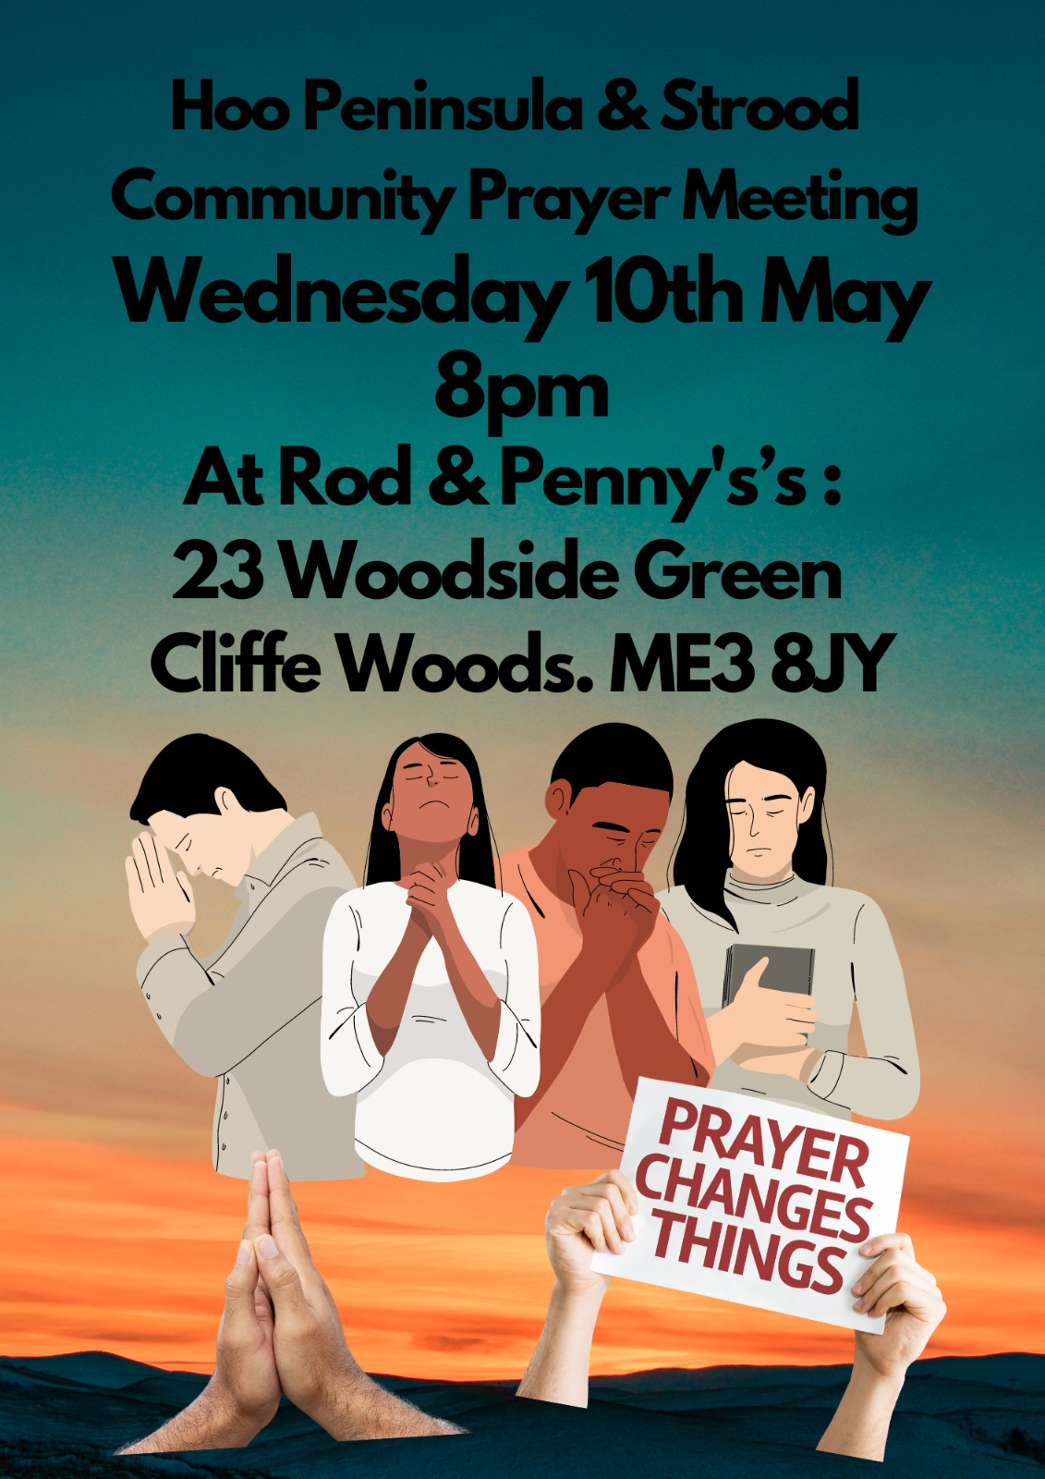

Slide 34


Slide 36
I Believe
CCLI Song # 7176941
Amanda Cook | Jason Ingram | Jonathan David Helser | Melissa Helser | Steffany Gretzinger
© 2021 We Are TIM Music (Admin. by Capitol CMG Publishing)
Wonder Meadow Music (Admin. by Capitol CMG Publishing)
All Essential Music (Admin. by Essential Music Publishing LLC)
Be Essential Songs (Admin. by Essential Music Publishing LLC)
Maison Publishing (Admin. by Essential Music Publishing LLC)
My Magnolia Music (Admin. by Essential Music Publishing LLC)
Bethel Music Publishing (Admin. by Song Solutions)
Quiltmaker Music (Admin. by Song Solutions)
For use solely with the SongSelect® Terms of Use. All rights reserved. www.ccli.com
CCLI Licence No. 33265

Slide 37
1/4
I believe in the blood of Jesus
That washes white as snow
I believe that the power of the Gospel
Still makes the broken whole
I believe that the curse of sin was broken
When they rolled away that stone
I believe I believe I believe

Slide 38
2/4
As I bow before You Lord I will rise in confidence
I will see Your goodness Lord
In the land I’m livin’ in
No matter where I go and no matter where I've been
I will see your goodness Lord
In the land I’m livin’ in

Slide 39
3/4
I believe that the walls will start falling
When we fall down on our knees
I believe that the lame will go walking
And the blind are gonna see
I believe that the gates of hell tremble
When the church begins to sing
I believe I believe I believe

Slide 40
4/4
Sing it to the daughters sing it to the sons
To every generation look what the Lord has done
Sing it to the darkness that the light has come
Sing it to the nations
Look at what the Lord has done
(Look at what the Lord has done)

